Slide 1
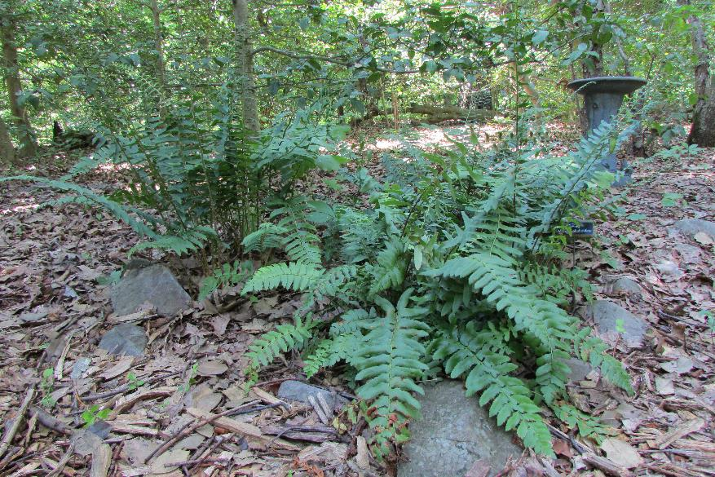
Native Shade Ground Covers
Photo: V Klocko
Woodland Garden at Kinder Farm Park, a AA County Master Gardener Project
This document was created by the Anne Arundel County Master Gardeners.
The University of Maryland Extension (UME) conducts the Maryland Master Gardener Program.
The Master Gardener Program’s mission is to educate Maryland residents about safe, effective, and sustainable horticultural- practices that build healthy gardens, landscapes, and communities.
It is the policy of the University of Maryland, College of Agriculture and Natural Resources, Maryland Agricultural Experiment Station, and University of Maryland Extension that all persons have equal opportunity and access to programs and facilities without regard to race, color, gender, religion, national origin, sexual orientation, age, marital or parental status, or disability.

Slide 3
What you will learn from this presentation:
Reasons for use of ground covers
Reasons for choosing native ground covers vs. non-native plants
An overview of native ground covers for specific conditions such as moisture, shade conditions, and soil conditions

Slide 4
By the end of this presentation you should be able to:
Further analyze your specific problem area for shade, moisture, soil conditions and landscape area.
Choose a ground cover that suits your situation and you enjoy.
Choose groundcovers that you could enjoy for their ecological value.

Slide 5
Why use a ground cover?
Erosion control – wind and rain
Reduce lawn with associated needs for watering, mowing, fertilizing, trimming
Attractive to birds, butterflies, and beneficial insects
Provide habitat for wildlife including birds, butterflies and beneficial insects
Landscape design – direct traffic, unify landscape, define space
Cools the air from non-pervious surfaces
Source: “Covering Ground” by Barbara Ellis, pg. 12-13

Slide 6
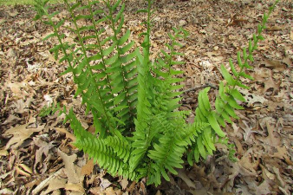
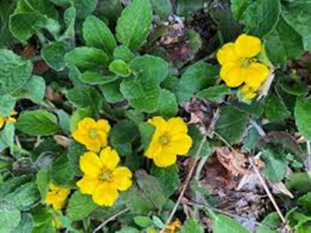
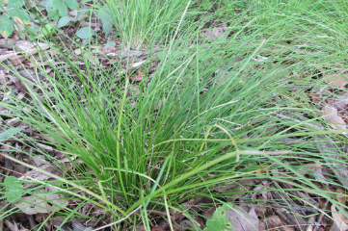
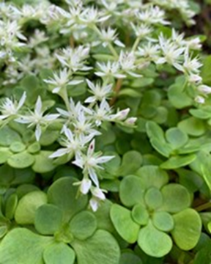
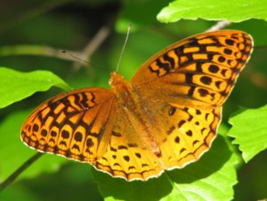
Rethinking Groundcovers
Layering groundcovers by height provides visual variety
Different bloom times over the year
Texture variety
Interplanting different plants maintains
soil integrity and conditions
More ecological value to property

Slide 7
Why use a native ground cover?
Evolved with other biota (regional animal and plant life)
Adapted to local soil and climate
Require less water and fertilizer
Resistant to insects and disease – no pesticides
Native wildlife use for food, shelter, and rearing young
Help balance the native ecosystem
Source: “USFWS Native Plants for Wildlife Habitat and Conservation Landscaping Chesapeake Bay Watershed” pg. 4

Slide 8
Locations
Full sun – Site receives six (6) hours of direct sunlight
Part shade – Site receives three (3) – six (6) hours of direct sunlight
Full shade – Site receives less that three (3) hours of direct sunlight or filtered sunlight
Source: USFWS pg. 8

Slide 9
Soil Conditions
Dry – Areas where water does not remain after a rain (i.e. full sun, slope, sandy soil, windy location
Moist – area where soil is damp and occasionally saturated
Wet – area is saturated for most of the growing season except during droughts
Source: USFWS pg. 8

Slide 10
Part Shade with Wet Soil
Site receives three to six hours of direct sunlight. Consider any deciduous trees when assessing the sunlight.
Wet soil is soil that is saturated for most of the growing season except for drought conditions.

Slide 11
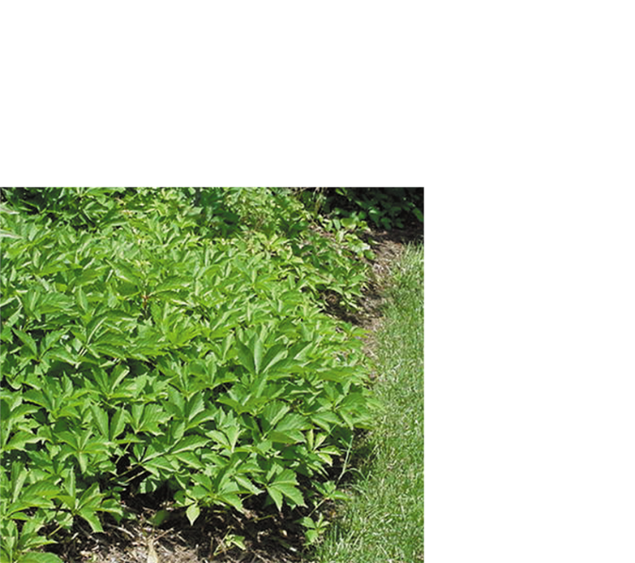
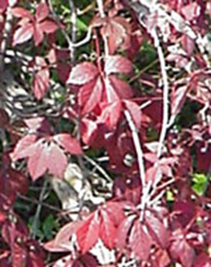
Virginia Creeper (Parthenocissus quinquefolia)
Vine spreading 25’-35’
Deciduous, purple to crimson fall color
Good for bank stabilization, control by trimming
Coastal, Piedmont, Mountain
Fruit eaten by a variety of wildlife
Late summer nectar and pollen source for bees and butterflies
Dry, Moist, Wet conditions
Sun, part shade, deep shade
Flowers – Green -white, June- August
Fruit – blue-black Sept.- Feb.
Soil – Clay, Sand, Loam
Some people may experience skin irritation.
Sources: USFWS pg. 65
“The Living Landscape” by Doug Tallamy pg. 302-303

Slide 12
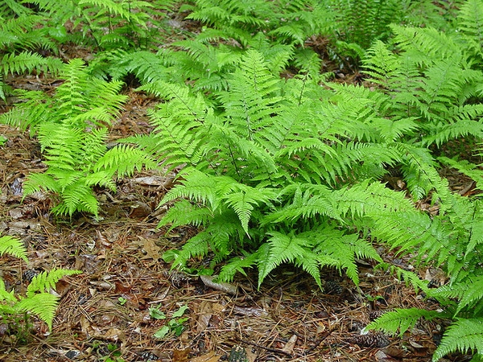
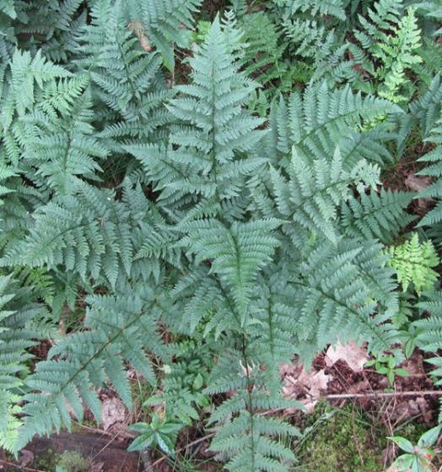
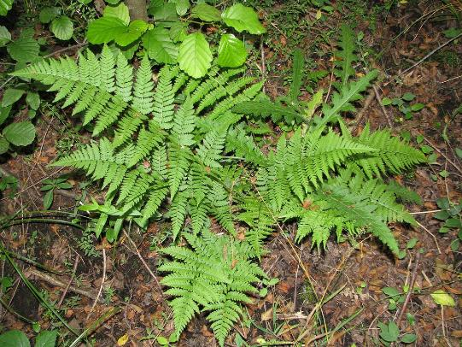
Selected Ferns for Wet Shade
Northern Lady Fern (Athyrium filix-femina)
Toothed or spinulose woodfern (Dryopteris carthusiana or D. spinulosa)
Evergreen wood-fern (Dryopteris intermedia)
Peggy A Lopipero Langmo CC BY 2.0
Homer Edward Price CC BY 2.0
Joseba Garmendia CC BY-SA 3.0
Source:https://plants.ces.ncsu.edu/plants/athyrium-filix-femina/
https://plants.ces.ncsu.edu/plants/dryopteris-carthusiana/
https://plants.ces.ncsu.edu/plants/dryopteris-intermedia

Slide 13
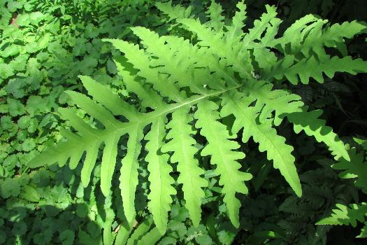
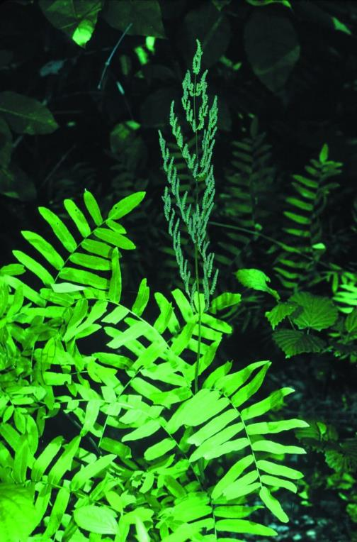
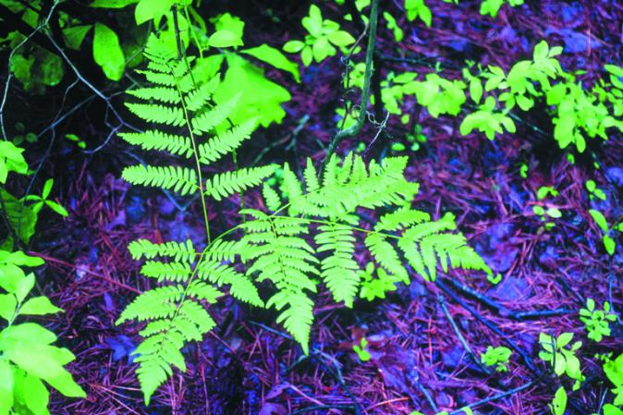
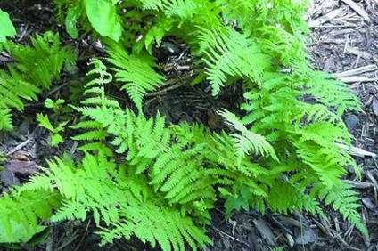
Photo: V. Klocko
Sensitive Fern (Onoclea sensibilis)
Bracken Fern
(Pteridium aquilinum)
Royal Fern (Osmunda regalis)
New York Fern
(Thelypteris noveboracensis)
Source: USFWS pg. 11-13

Slide 14
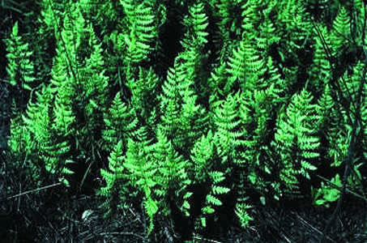
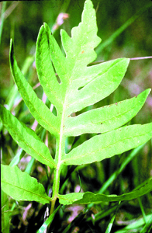
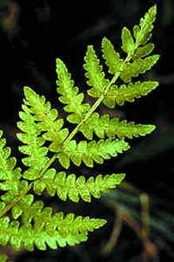
Marsh Fern
(Thelypteris palustris)
Netted Chain Fern (Woodwardia areolata)
Virginia Chain Fern
(Woodwardia virginica)
Source: USFWS pg. 11-13

Slide 15
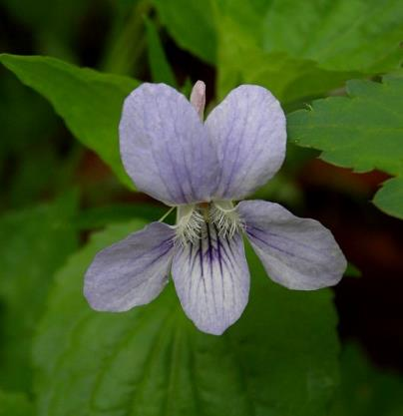
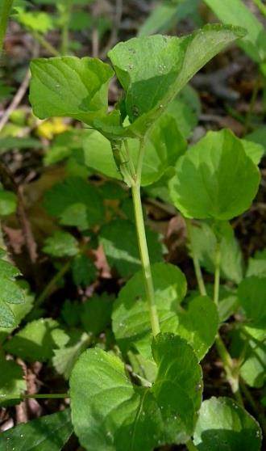
American Dog Violet (Viola conspersa)
Height – 0.5’-1’
Flower – Apr.- July pale blue violet
Fruit – green capsule
Moisture – Moist, wet
Region – Mountain, Piedmont, Coastal
Woods, swamps, and fields
Larval host for fritillary butterflies
USFWS pg. 39
“The Living Landscape” by Rick Darke and Doug Tallamy, pg. 316-317
Great Spangled Fritillary
https://www.illinoiswildflowers.info/woodland/plants/dog_violet.htm
Source: Butterflyidentification.com

Slide 16
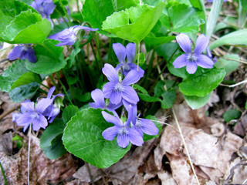
Marsh Blue Violet (Viola cucullate)
Height - 0.0-0.5”
Soil Type –clay, loam, sand
Light - Part Shade, Dense Shade
Moisture – wet, moist
Native area –Mountain, Piedmont, Coastal
Bogs, meadows, swamps
May be used by migratory birds and shelter for small animals
Deciduous
Flowers –pale purple
Bloom time – Apr.- June
Self -sows; can become a nuisance
Green fruit capsule
USFWS pg. 39
Photo: wildflower.org Thomas L. Muller

Slide 17
Part Shade with Moist Soil
Site receives three to six hours of sunlight. Consider deciduous trees when assessing light.
Soil is moist and may be damp and occasionally saturated

Slide 18
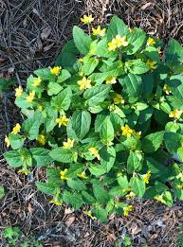
Green and Gold (Chrysagnum virginianum)
Height and Width -0.5’ -1.0’
Soil Type –clay, loam, sand
Light - Sun, Part Shade, Dense Shade
Moisture –moist, dry
Native area –Mountain, Piedmont, Coastal
Pollinators – food for early pollinators
Shelter for wildlife
Growth Characteristics – open woods on limestone, rocky open woods
Deciduous
Yellow Flowers March - June
7SSH3H
Sources: USFWS pg.21
“The Living Landscape” by Rick Darke and Doug Tallamy, pg. 306-307
Photo:https://plants.ces.ncsu.edu/plants/chrysogonum-virginianum

Slide 19
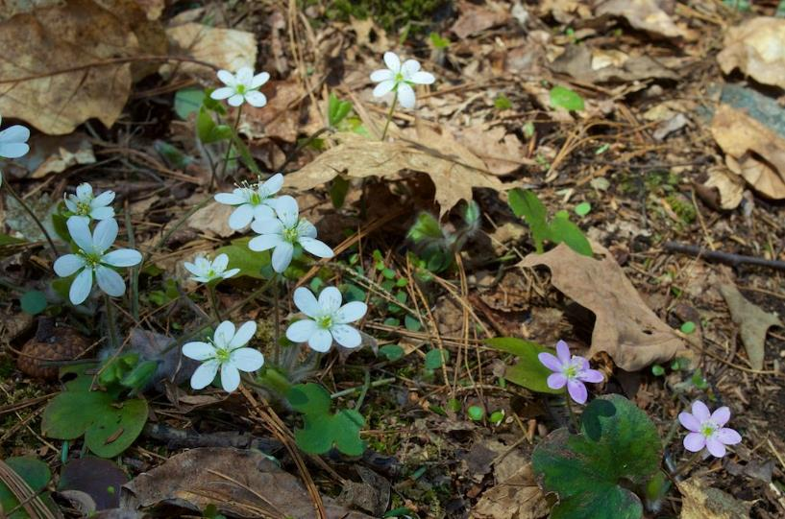
Round-Lobed Hepatica (Hepatica nobilis var. obtusa)
Height - 0.5’ – 2’
Soil Type –loam, sand
Light -Part Shade, Dense Shade
Moisture –moist, dry
Native area –Mountain, Piedmont, Coastal
Habitat -dry or rocky woods, dry upland slopes
Deciduous
White to lavender flowers – March - June
Fruit capsule
Distant Hill Gardens is licensed under CC BY-NC-SA 2.0
Source: USFWS pg. 25

Slide 20
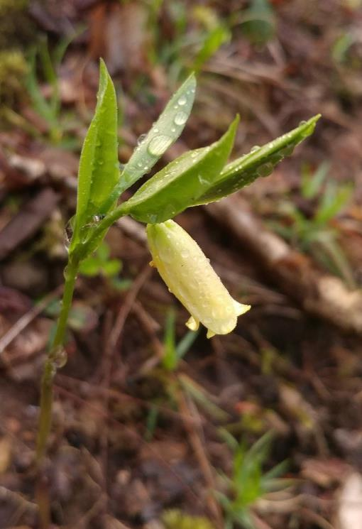
Straw Lily (Uvularia sessilifolia)
Height - 0.5’ – 1.0’
Soil Type –loam, sand
Light - Sun, Part Shade, Dense Shade
Moisture –moist, dry
Native area –Mountain, Piedmont, Coastal
Habitat - dry to moist woodland
Deciduous
Yellow flowers – May – June
Rhizomes can be cooked and eaten, young shoots can be substituted for asparagus
Source: USFWS pg.38
Photo: Matt Tillett is licensed under CC BY-NC-ND 2.0

Slide 21
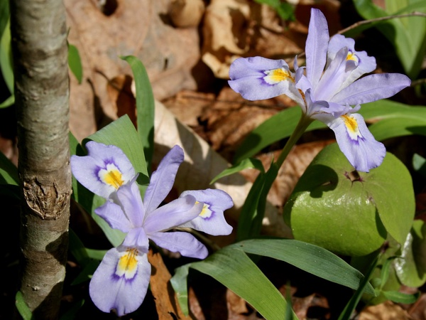
Dwarf Crested Iris (Iris cristata)
Height and Width – 0.5’ - 1’, spread
Soil Type – rocky areas
Light - Part Shade (also sun)
Moisture –moist
Pollinators -early nectar source
Deciduous ground cover spreads to 1’
Blue, white flowers
Bloom time – April - May
Tolerates drought, deer resistant
Source: MBG Plant Finder
MD Native Plant Society
“The Living Landscape” by Rick Darke and Doug Tallamy, pg.353 Photo: OakleyOriginals is licensed under CC BY 2.0

Slide 22
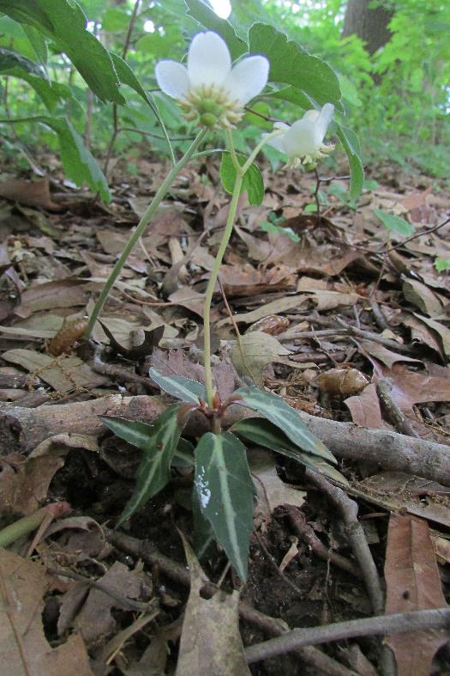
Striped Wintergreen, Striped Prince’s Pine (Chimaphilia maculata)
Height -0.5’
Soil Type –clay, loam, sand
Light - Part Shade, Dense Shade
Moisture – dry
Native area –Mountain, Piedmont, Coastal
Habitat -acidic woods frequently under pines
Deciduous
Fragrant white flowers – June - August
Source: USFWS pg. 21
Photo: V. Klocko

Slide 23
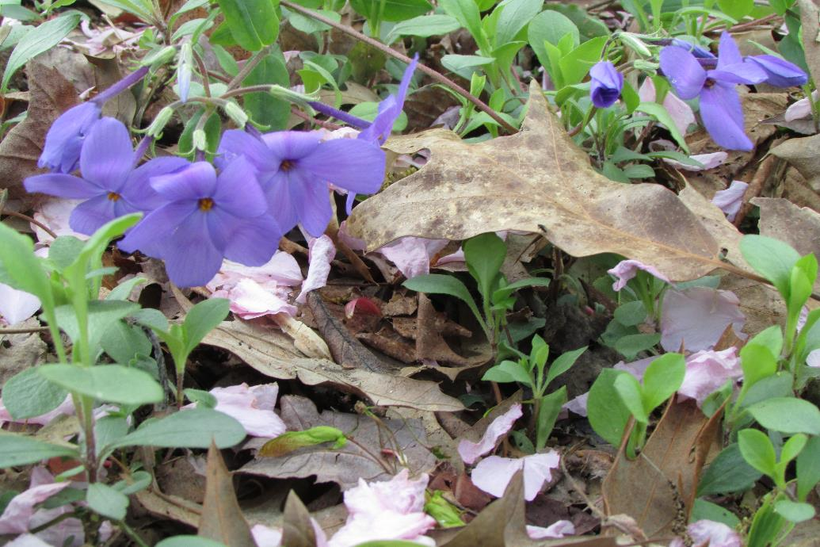
Woodland Phlox (Phlox divaricata)
Height – 1.5’
Soil Type – pH 5.5 – 7.2, clay, loam
Light - Part shade, dense shade
Moisture –moist
Native area – Mountain, Piedmont, Coastal
Habitat -rich woods
Blue, lavender, and white flowers April- June
Provides nectar for hummingbird sphinx moth
Shelter for wildlife
Fruit capsule
Photo: V. Klocko
Source: USFWS pg. 31
“The Living Landscape” by Rick Dark and Doug Tallamy, pg. 312-313

Slide 24
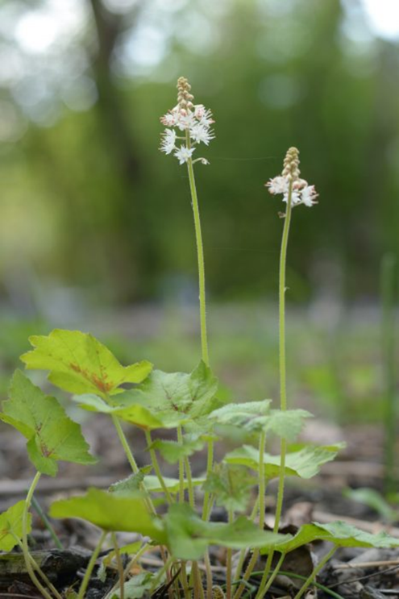
Foamflower (Tiarella cordifolia)
Height -0.5’-1’
Soil Type –loam
Light - Part Shade, Dense Shade
Moisture –moist
Native area –Mountain, Piedmont, Coastal
Habitat -rich woods, moist rocky wooded slopes
Spring pollen and nectar source
Shelter for wildlife
Deciduous
White Flowers – April- July
Clump forming
Fruit - capsule
Source(s): USFWS pg. 38,
“The Living Landscape” by Rick Darke and Doug Tallamy, pg. 314-315

Slide 25
Wild Stonecrop (Sedum ternatum)
Height – 0.1 -0.5’
Light – Full Sun - Part Shade
Moisture –moist
Native area –Mountain, Piedmont, Coastal
Pollinators -some benefits for pollinators
Evergreen
White blossoms from April-May
Slow growth
Tolerates deer, rabbits, air pollution, drought
Maybe planted with taller plants
Photo: V. Klocko
Sources: Missouri Botanical Garden,
Maryland Native Plant Society,
“Chesapeake Gardening and Landscaping” by Barbara Ellis, pg. 162

Slide 26
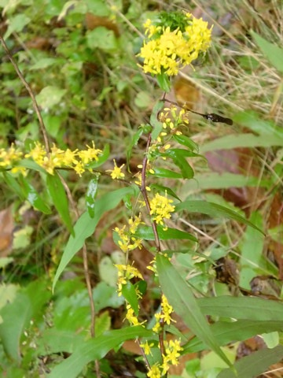
Bluestem Goldenrod (Solidago caesia)
Height -1’-3.5’
Soil Type – pH 5.5-7, clay, loam
Light - Sun, Part Shade, Dense Shade
Moisture –moist, dry
Native area – Mountain, Piedmont, Coastal
Habitat – rich deciduous woods
Pollen and nectar producer
Shelter and seed producer
Food for 115 species of caterpillars
Yellow flowers August – October
Fruit capsule
Sources: USFWS pg. 35
“The Living Landscape” by Rick Darke and Doug Tallamy, pg. 314-315
Photo: elizawbarrett is licensed under CC BY 2.0

Slide 27
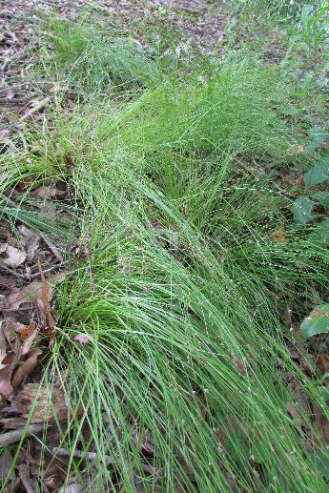
Pennsylvania Sedge (Carex pennsylvanica)
Height 0.5’-1.5’
Soil Type –sand
Light -Part Shade, Dense Shade
Moisture –moist, dry
Native area –Mountain, Piedmont, Coastal
Habitat – open, dry, sandy or rocky woods, wooded slopes
Pollinators – food for caterpillars, pollen producer, larval host for 36 caterpillars, nectar producer
Songbird and waterfowl support
Evergreen – finely textured leaves less than 6”
Reddish-white flowers that bloom April- July
Slow growing clump forming to 20”
Special Uses to consider -wooded slopes, alternative to lawns, plant densely
Sources: USFWS pg. 11
“The Living Landscape” by Rick Darke and Doug Tallamy, pg. 318-319
Photos: V. Klocko

Slide 28
Christmas Fern (Polystichum acrostichoides)
Height – 0.5-2’
Soil Type – loam, sand, impartial to soil pH
Light – Sun, Part Shade, Dense Shade
Moisture –moist, dry
Native area –Mountain, Piedmont, Coastal
Habitat – woods, thickets, shallow rocky slopes
Shelter – cover for ground fauna
Evergreen clumps, tolerates drought (MBG*)
Spores – June – Oct.
Special Uses to consider -slope/bank plantings good for erosion control,
plant into bank to prevent crown rot in areas with poor drainage
Other Needs for the plant –rabbit and deer resistant (usually)
Sources: USFWS pg.12
*Missouri Botanical Garden Plant Finder
“The Living Landscape” by Rick Darke and Doug Tallamy, pg. 320
Photo: V Klocko

Slide 29
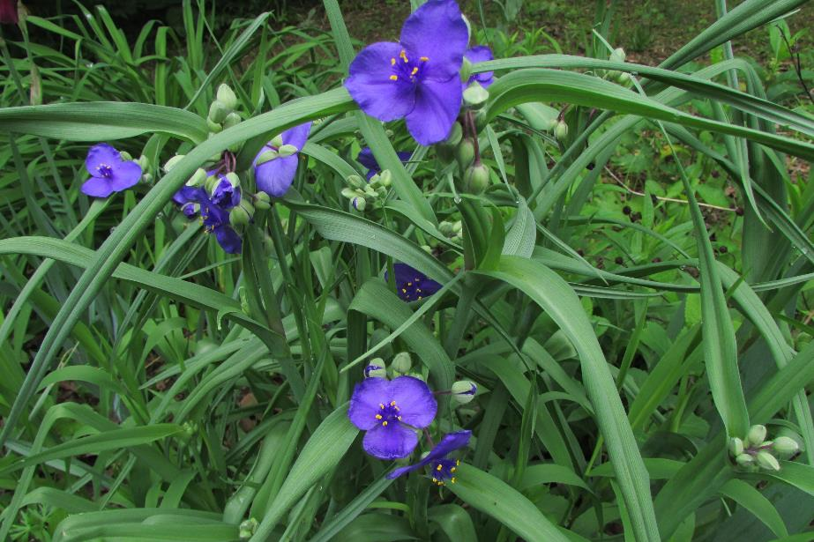
Spiderwort (Tradescantia virginiana)
Height – 1.0’ -3.0’
Soil Type – pH 4 – 8, clay, loam
Light – full sun, part shade, shade
Moisture –moist
Native area –Mountain, Piedmont, Coastal
Wooded slopes, shale outcroppings,
fields, roadsides
Pollen and nectar producer
Deciduous
May – June deep blue-purple flowers
Photo: V Klocko
Source: “The Living Landscape” by Rick Darke and Doug Tallamy, pg. 355
USFWS pg. 38

Slide 30
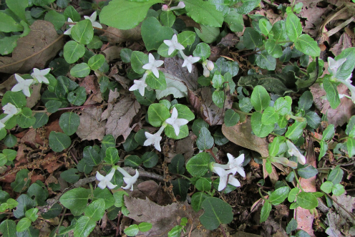
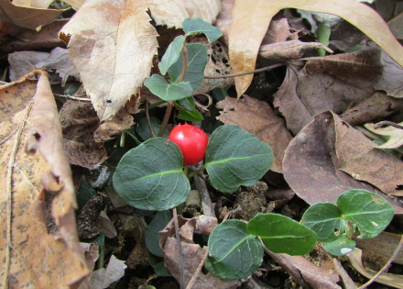
Partridgeberry (Mitchella repens)
Height – 0.5” Slow spreader
Flowers – May-July
Fruit – two flowers form one scarlet fruit
Growth – forms a mat under trees,
dry acidic woods, evergreen groundcover
Regions – Mountains, Piedmont, Coastal
Soil – Loam and Sand
Ecological Value – supports birds and small mammals,
nectar producer, cover for wildlife, food for wintering birds
Source: USFWS pg. 29
“The Living Landscape” by Rick Darke and Doug Tallamy, pgs. 312-313, 330-331
Photos: V. Klocko

Slide 31
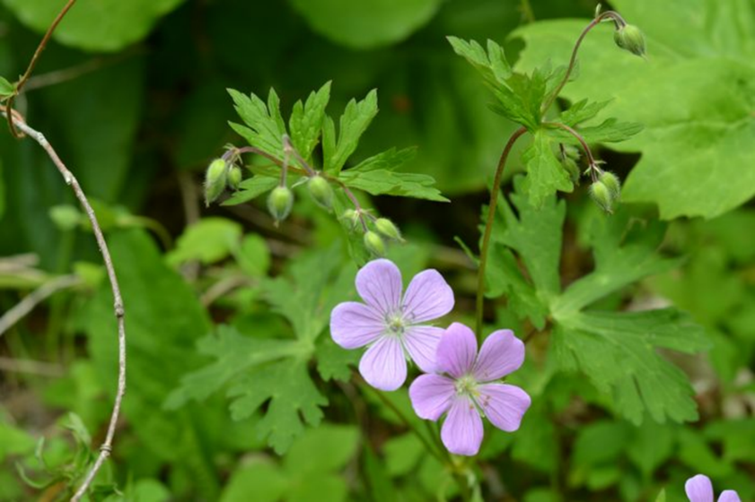
Wild Geranium (Geranium maculatum)
Height and width: 1-2 feet tall,
Soil Type –loam
Light - Sun, Part Shade
Moisture – moist, dry
Native area – Mountain, Piedmont, Coastal
Flowers – Lavender or pink, May-July
Habitat – woods, roadsides, fields
Produces pollen and nectar
Supports butterflies, birds, beneficial insects
Sources: www.fs.fed.us
Wildflowers.org
“The Living Landscape” by Rick Darke and Doug Tallamy, pgs. 308-309
https://extension.umd.edu/sites/extension.umd.edu/files/_images/programs/hgic/Publications/HG120_NativePlantsofMD.pdf
USFWS pg. 24

Slide 32
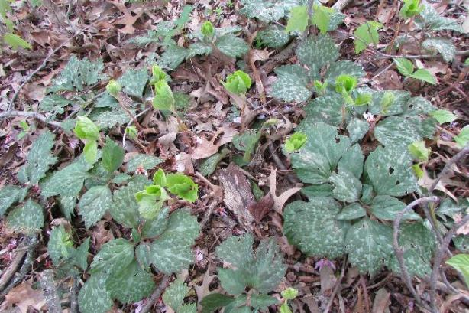
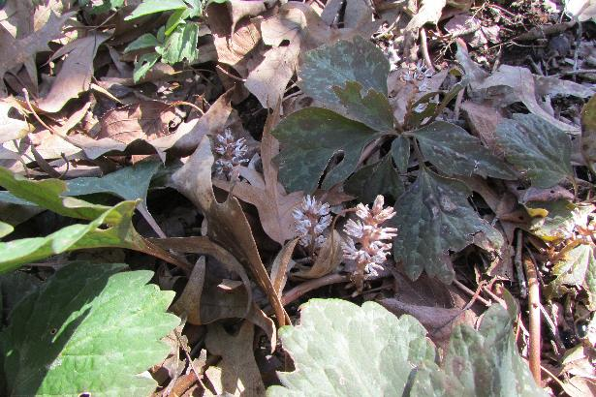
Allegheny spurge (Pachysandra procumbens)
Height – 6” to 12"
Bloom Time – March through April
Fruit - Dry capsules, seldom produced in any quantity.
Not ornamentally important.
Light – Dappled sunlight, part shade to full shade
Growth – grows under trees and shrubs
found in moist rich woods, not invasive.
Regions – Mountains, Piedmont, Coastal
Soil – Loam (Silt), Clay, Sand
Ecological Value – supports bees and predatory insects,
cover for wildlife, low maintenance
Source: North Carolina State Extension Gardener Plant Toolbox
Izel Native Plants website
Photos:V. Klocko

Slide 33
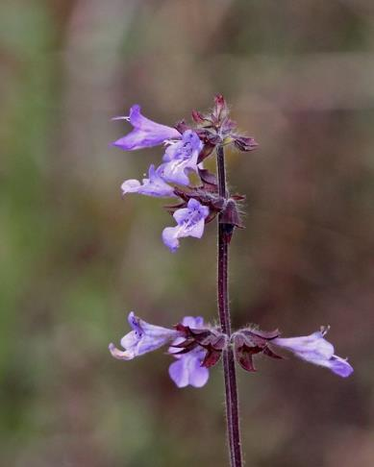
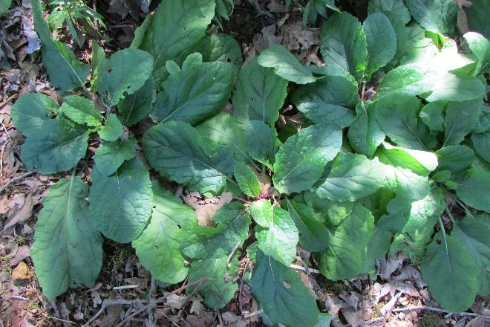
Lyre-Leaf Sage (Salvia lyrata)
Height 1’-2’
Soil Type –loam, sand
Light - Sun, Part Shade
Moisture –moist, dry
Native area –Mountain, Piedmont, Coastal
Habitat - moist pastures, upland woods, thickets, waste areas
Attracts butterflies and hummingbirds
Provides shelter for wildlife
Deciduous
April- June violet flowers
Nut/nutlike fruit
Mary Keim is licensed under CC BY-NC-SA 2.0
Sources: USFWS pg. 33
“The Living Landscape” by Rick Darke and Doug Tallamy pg. 314-315
V. Klocko

Slide 34
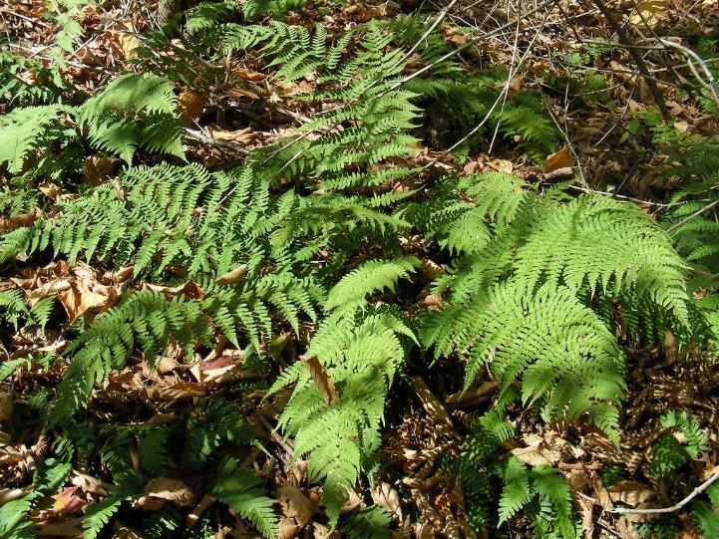
Marginal Woodfern (Dryopteris marginalis)
Height -1’-3’
Soil Type –clay, loam, sand
Light - Sun, Part Shade, Dense Shade
Moisture –moist, dry,
Native area –Mountain, Piedmont, Coastal
Habitat -likes winter oak leaf cover
Shelter for toads and lizards
Evergreen
Clump forming, easily transplanted
Photo: K.P. McFarland is licensed under CC BY-NC 2.0
Sources: wildflowers.org
USFWS pg.12

Slide 35
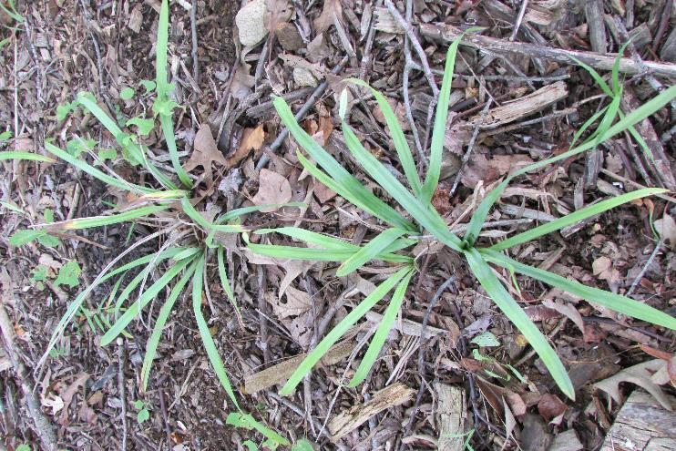
Blue Sedge (Carex glaucodea)
Height – 0.5’-2’
Light - Part Shade, Dense Shade
Moisture –moist, dry,
Native area –Piedmont, Coastal
Habitat -moist to dry woods
Cover for wildlife, pollen and nectar producer,
larval host for skipper butterflies
Deciduous/ evergreen
Reddish Flowers May – June
Clump forming alternative to Lirope
Photo: V. Klocko
Source(s): wildflowers.org
“The Living Landscape” by Rick Darke and Doug Tallamy pg. 318-319
USFWS pg. 14

Slide 36
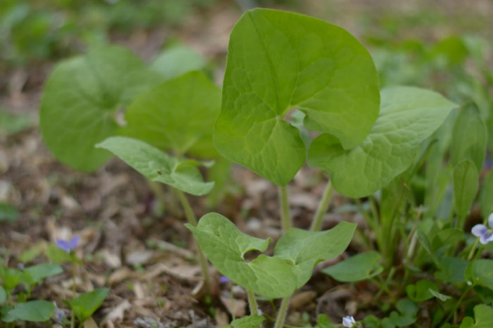
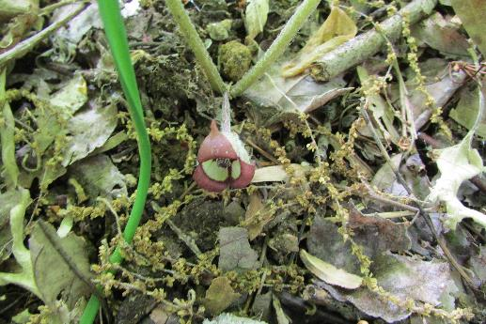
Wild Ginger (Asarum canadense)
Height – 0.5’
Growing Conditions
Soil Type – best pH 6-7, clay, loam, sand
Light - Part Shade, Dense Shade
Moisture –moist, dry,
Native area –Mountain, Piedmont, Coastal
Habitat -rich woods
Low colony forming perennial, does not like high heat Deciduous/semi-evergreen
Red, green, purple, brown blossoms April - June
May cause skin irritation to some people
Source(s): wildflowers.org
USFWS pg. 19
Photos: V. Klocko

Slide 37
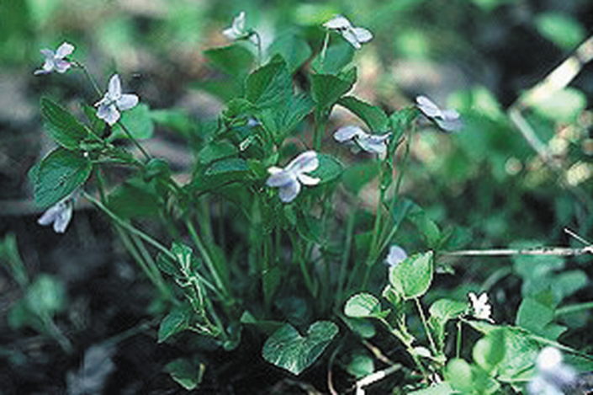
American Dog Violet
(Viola conspersa)
Marsh Blue Violet
(Viola cucullata)
Virginia Creeper
(Parthenocissus quinquefolia)

Slide 38
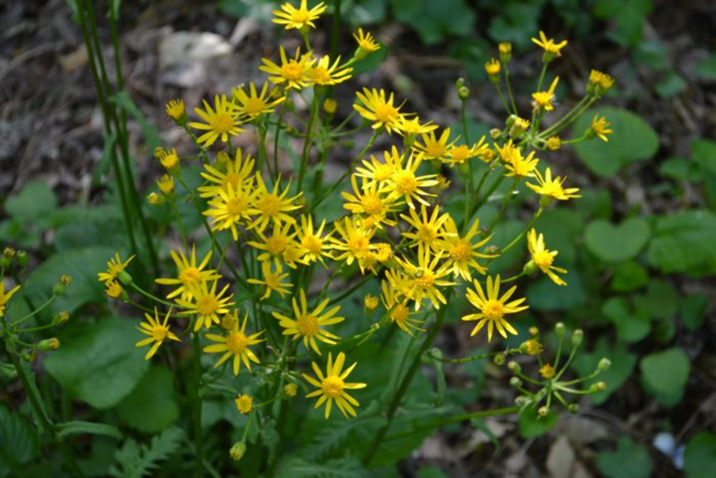
Golden Ragwort (Packera aurea) (Senecio aureus)
Height -0.5’-2.5’
Soil Type –loam
Light - Sun, Part Shade, Dense Shade
Moisture – wet, moist
Native area –Mountain, Piedmont, Coastal
Habitat – Moist fields, flood plains, woods, roadsides
Pollen and nectar producer
Deciduous
Yellow Flowers – April - Aug
Aggressive
Fruit capsule
Special Uses – an area that may be periodically
flooded
Sources: “The Living Landscape” by Rick Darke and Doug Tallamy pg. 314-315
USFWS pg.30

Slide 39
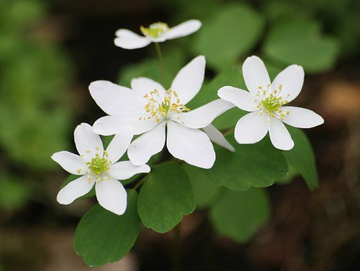
Rue Anemone (Thalictrum thalictroides)
Height – grows up to 9 “
Soil Type – pH, clay, loam, sand
Light - Part Shade, Dense Shade
Moisture –dry, moist
Native area –Mountain, Piedmont, Coastal
Habitat – wooded banks and thickets
Deciduous
White or pink blossoms Mar.-June
Can cause skin blistering if touched by sap
Source(s): wildflowers.org
USFWS pg. 37
Photo: janet.powell is licensed under CC BY-NC-SA 2.0

Slide 40
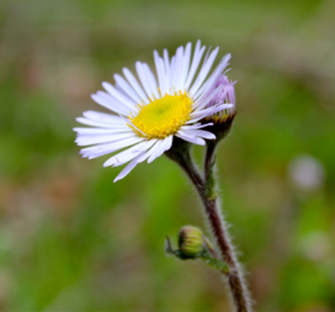
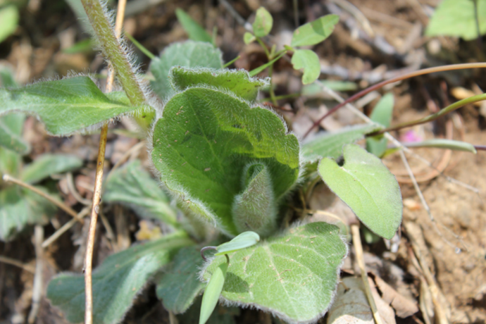
Robin’s Plantain, Fleabane, Blue spring daisy
(Erigeron pulchellus)
Height and Width: 1.5-2.0 feet high and wide
Native – Mountains, Piedmont, Coastal
Soil type - Loam, sand
Moisture - dry to moist soil
Tolerates light shade especially in hot summer sun
Attracts butterflies
Herbaceous, deciduous, perennial, part shade
Good low growing ground cover; low maintenance
Slow spreading
Sources: Wikipedia
Virginiawildflowers.org
Missouribotanicalgarden.org
Mtcubacenter.org
U.S Fish and Wildlife Service Native Plants for Wildlife Habitat and Conservation Landscaping, pg.23

Slide 41
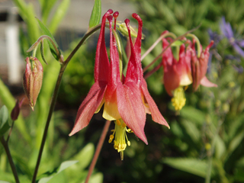
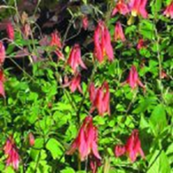
Wild Columbine (Aquilegia canadensis)
Height – 3’ Width 1.5’
Soil Type –loam
Light - Sun, Part Shade
Moisture –moist, dry
Native area –Mountain, Piedmont, Coastal
Habitat – rich woods, slopes
Attracts hummingbirds, butterflies and bees — good wildlife food source
Deciduous
Flowers lowers are yellow/gold, red/burgundy and pink with bell-like tubular flowers — early spring Mar-Jun - 3 ft and 1.5 ft wide
Spreads by seeds, resistant to leaf miner
Sources: NC Extension Gardener - part of Cooperative Extension of State University
USFWS pg.18
Wildflower.org Julie Malkin

Slide 42
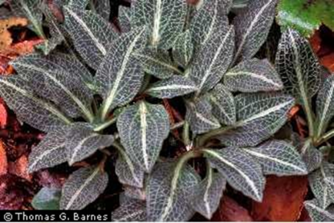
Downy Rattlesnake Plantain, Adders Violet (Goodyera pubescens)
Height 0.5 “– 1.5 “ Width 0.5’ – 1.5’
Growing Conditions
Soil Type – Acidic, clay, loam, sand
Light - Part Shade
Moisture – Dry to moist upland woods
Produces whiteish flowers June to August
Evergreen
Sources: Georgia’s Native Plants; www.GNPS.org
www.Plants.usda.gov
U.S Fish and Wildlife Service. Native Plants for Wildlife Habitat and Conservation Landscaping pg. 24
US Forest Service, www.fs.fed.us

Slide 43
Part Shade with Dry Soil
Site receives three to six hours of sunlight. Consider deciduous trees when assessing light.
Soil where water does not remain after rain, a steep slope, or sandy soil. Plants are considered as drought tolerant.

Slide 44
Gray Goldenrod (Solidago nemoralis)
Height – 1.5’ width x 2’ height (leaves up to 4”)
Flowers – fall, numerous yellow compound
Growth – tendency to group, full sun, dry open woods, fields, forms an effective groundcover
Regions – zones 2-9 (north to Canada, south to Georgia, west to Texas)
Soil – dry, non-fertile conditions (sand, clay, gravel)
Ecological Value – supports insects, pollen and nectar producer, seeds for birds
Source: USDA, Natural Resources Conservation Service “Plant Fact Sheet” https://plants.usda.gov/factsheet/pdf/fs_sone.pdf
Photo: "Goldenrod" by StevenM_61 is licensed under CC BY-NC-ND 2.0

Slide 45
Eastern Hay-Scented Fern (Dennstaedtia punctilobula)
Height – 1’-3’ width 2’-3’
Soil – Prefers slightly acidic loam soils like in open woods and pastures
Tolerates sun and partial shade
Moisture – Tolerates dry conditions prefers moist and well-drained soils
Native area –Mountain, Piedmont, Coastal
Deciduous fern, with fronds yellowing in the fall
Aggressive spread by rhizomes to form large colonies in favorable conditions
Special Uses to consider – Deer resistant fern, more tolerant (once established) of sun and dry conditions than most native ferns
Source: USFWS pg.11
Photos: https://www.wildflower.org/gallery/result.php?id_image=59931
https://www.wildflower.org/gallery/result.php?id_image=38700

Slide 46
Marginal Wood Fern (Dryopteris marginalis)
Height -1’-3’
Soil Type –clay, loam, sand
Light - Part Shade, Dense Shade
Moisture –moist, dry
Native area –Mountain, Piedmont, Coastal
Habitat -likes winter oak leaf cover
Shelter for toads and lizards
Evergreen
Clump forming, easily transplanted
CC BY-NC-SA 2.0 tpotterfield
Source(s): wildflowers.org
USFWS pg.12
Photo: Sally and Andy Wasowski

Slide 47
Allegheny spurge
(Pachysandra procumbens)
Lyre Leaf Sage
(Salvia lyrate)
Photos: V. Klocko
Partridgeberry (Mitchella repens)

Slide 48
Blue Sedge
(Carex glaucodea)
Virginia Creeper
(Parthenocissus quinquefolia)
Pennsylvania Sedge
(Carex pennsylvanica)
Photos: USFWS
V. Klocko

Slide 49
Wild Geranium (Geranium maculatum)
Robin’s Plantain
(Erigeron pulchellus)
Green and Gold
(Chrysagnum virginianum)

Slide 50
Plants for Wet Deep Shade
Evergreen wood-fern
(Dryopteris intermedia)
New York Fern
(Thelypteris noveboracensis)
Toothed or spinulose woodfern
(Dryopteris carthusiana or D. spinulosa)

Slide 51
American Dog Violet
(Viola conspersa)
Marsh Blue Violet
(Viola cucullata)
Virginia Creeper
(Parthenocissus quinquefolia)

Slide 52
Golden Ragwort (Packera aurea) (Senecio aureus)

Slide 53
Deep Shade with Moist Soil
Site receives less that three hours of direct or filtered light
Soil is damp and occasionally saturated

Slide 54
White Wood Aster (Eurybia divaricata) (Aster divaricatus)
Height – 0.5’-3.0’
Light – Pat shade, deep shade
Moisture – dry to moist
Region – Mountain, piedmont
Blossoms – July – Oct., white
Growth – deciduous
Ecological Value – Hosts 109 caterpillars, pollen producer, nectar source
Source : USFWS pg. 24
“The Living Landscape” by Rick Darke & Doug Tallamy pgs. 304 - 305, 363
Photos: V. Klocko

Slide 55
Rattlesnake Fern (Botrypus virginianus)
Height – 1’-2’
Soil – Loamy
Light – Deep Shade
Moisture – Dry to Moist
Native Area – Mountains, Piedmont, Coastal
Wildlife cover and bird nesting site
Sources: USFWS
Wikipedia
USDA.gov
Permculture
Ontario Ferns
“The Living Landscape” by Rick Darke and Doug Tallamy

Slide 56
Wild Stonecrop
(Sedum ternatum)
Allegheny Spurge
(Pachysandra procumbens)
Partridgeberry
(Mitchella repens)

Slide 57
Bloodroot (Sanguinaria canadensis)
Height - .05’
Soil Type – pH - acid, loam
Light - Dense Shade
Moisture –moist, dry
Native area –Mountain, Piedmont, Coastal
Habitat -leaf litter of deciduous woods
Pollen and nectar producer
Ants eat seed parts and help disperse seeds
Deciduous
Short lived white flowers in April
V. Klocko
S. Shreet
Sources: Rick Darke & Doug Tallamy “The Living Landscape) pg. 49, 314-315
https://mtcubacenter.org/plants/bloodroot/
missouribotannicalgarden.org
plants.usda.gov
wildflower.org

Slide 58
Round-Lobed Hepatica
(Hepatica nobilis var. obtusa)
Foamflower
(Tiarella cordifolia)
Straw Lily
(Uvularia sessilifolia)

Slide 59
Wild Ginger
(Asarum canadense)
Green and Gold
(Chrysagnum virginianum)
Spiderwort
(Tradescantia virginiana)

Slide 60
Deep Shade and Dry Soil
Site receives less than three hours of direct sunlight or filtered sunlight.
Soil where water does not remain after rain, a steep slope, or sandy soil. Plants are considered as drought tolerant

Slide 61
Allegheny Spurge
(Pachysandra procumbens)
Partridgeberry
(Mitchella repens)
White Wood Aster (Eurybia divaricate)
(Aster divaricatus)

Slide 62
Green and Gold
(Chrysagnum virginianum)
Round-Lobed Hepatica
(Hepatica nobilis var. obtusa)
Bluestem Goldenrod
(Solidago caesia)

Slide 63
Marginal Woodfern
(Dryopteris marginalis)
Virginia Creeper
(Parthenocissus quinquefolia)
Straw Lily
(Uvularia sessilifolia)

Slide 64
This presentation summarizes the possible native plants that
could be incorporated
in gardens in the Coastal, Piedmont,
and Mountain areas in Maryland.
Source: USFWS Native Plants for Wildlife Habitat and Conservation Landscaping Chesapeake Bay Watershed

Slide 65
References
Native Plants for Wildlife Habitat and Conservation Landscaping Chesapeake Bay Watershed U.S. Fish & Wildlife Service 2003
Covering Ground, ©2007 by Barbara Ellis
The Living Landscape, © 2014 by Rick Darke & Doug Tallamy
https://mtcubacenter.org/plants
https://www.missouribotanicalgarden.org/PlantFinder/
https://plants.sc.egov.usda.gov
https://www.wildflower.org/
https://plants.usda.gov/factsheet/pdf/fs_sone.pdf
Georgia’s Native Plants; www.GNPS.org

Slide 66
References (Cont.)
US Forest Service, www.fs.fed.us
Maryland Native Plant Society
https://virginiawildflowers.org/
Wikipedia
Chesapeake Gardening and Landscaping © 2015 by Barbara Ellis
USDA.gov
Permiculture
Ontario Ferns
https://plants.ces/ncsu.edu/plants
https://creativecommons.org

Slide 67
Anne Arundel

