Slide 1
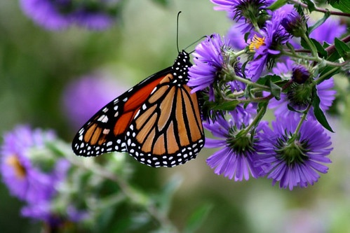
Monarch Butterflies
CC PDM 1.0
Created by the Master Gardeners of Anne Arundel County Maryland
The University of Maryland Extension (UME) conducts the Maryland Master Gardener Program.
The Master Gardener Program’s mission is to educate Maryland residents about safe, effective , and sustainable horticultural- practices that build healthy gardens, landscapes, and communities.
It is the policy of the University of Maryland, College of Agriculture and Natural Resources, Maryland Agricultural Experiment Station, and University of Maryland Extension that all persons have equal opportunity and access to programs and facilities without regard to race, color, gender, religion, national origin, sexual orientation, age, martial or parental status, or disability. (Not all prohibited bases apply to all programs.)
T
February, 2021

Slide 3
What you may learn from this presentation:
Where monarch butterflies live, migrate, and undergo metamorphosis from a caterpillar to a butterfly.
How monarch butterflies are important in family remembrances.
How to tell the differences between butterflies and moths.
What caterpillars and butterflies need to survive.
Understand the challenges that monarchs face.
What you can do to help the monarchs thrive.

Slide 4
By the end of this presentation you should understand:
The life cycle of the monarch butterfly and its migration
Importance to family celebrations
Identify the difference between butterflies and moths
The importance of host and nectar plants
Causes for the population decline
Actions that can be taken by individuals that can encourage their success

Slide 5
Monarch Butterfly Annual Cycle
Source: www.lerner.org/north/monarch/index/html
Notes:
Monarchs overwinter in the fir forests of Mexico. Beginning in March they begin to leave Mexico, mate fly north to lay eggs, then die. Those eggs hatch and the cycle repeats itself with each subsequent generation flying further north. The forth generation does not lay any eggs, but goes into a reproductive pause and flies to Mexico for the winter.

Slide 6
Eastern and Western Monarchs
Eastern Monarchs (east of the Rocky Mountains) migrate to the Oyamel fir forests in Mexico.
Western Monarchs (west of the Rocky Mountains) overwinter along the coast in California near Santa Cruz and San Diego in the eucalyptus, Monterey pines, and Monterey cypress trees.
Source: www.fs.fed.us/wildflowers/pollinators/Monarch_Butterfly/migration/index.shtml

Slide 7
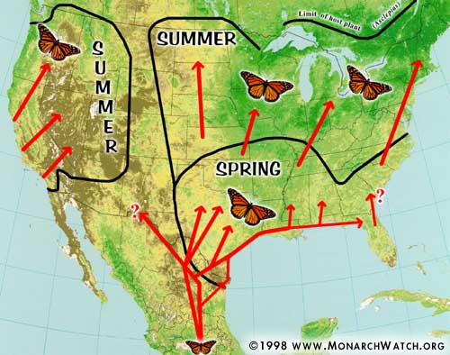
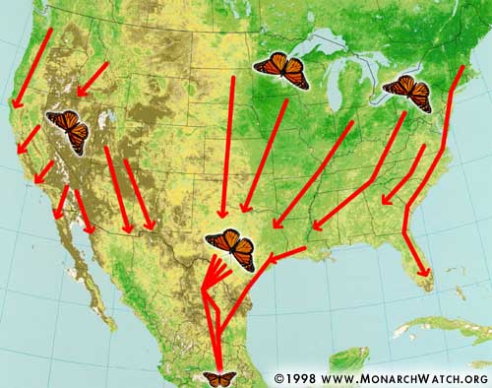
Monarch Migration
Spring to Summer Migration Fall Migration
Source: MonarchWatch.org

Slide 8
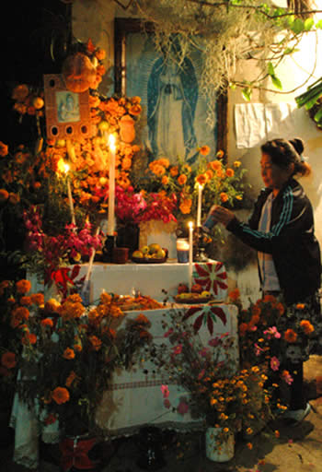
Monarch Fall Migration
Woman tending her ofrenda, honoring her deceased ancestors. The celebration lasts from October 31 until November 2.
Monarch migration culminates around October 31.
This corresponds with the Mexican celebration of the Day of the Dead (Dia de Los Muertos), a celebration based on European and indigenous traditions honoring the dead.
The butterflies represent the souls of the dead returning to Earth for a visit.
https://www.learner.org/jnorth/tm/monarch/DiaMuertosTG.html
https://www.mexicansugarskull.com/support/dodhistory.html
Notes:
The Disney Pixar movie “Coco” is based on the Dia de los Muertos. October 31 is the Dia de Los Angelitos commemorating the spirits of the deceased children.

Slide 9
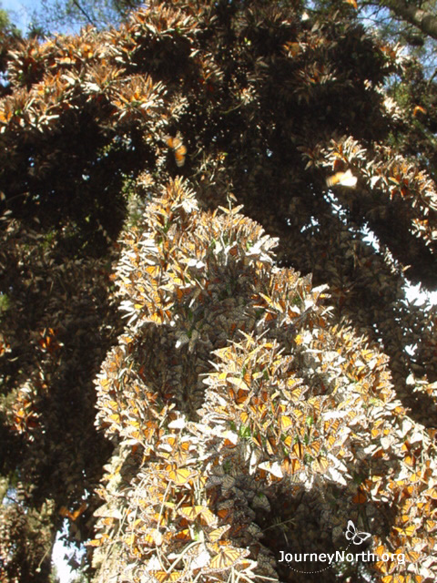
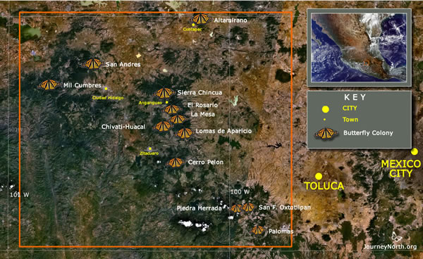
Monarch Butterflies Spending Their Winter in Mexico
Source: JourneyNorth.org
Notes:
The fir forests are about 10,000 feet above sea level with no nectar plants to sustain the overwintering monarch population. The cold-blooded animals gather together in the trees for warmth.

Slide 10
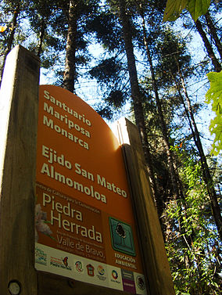
The Monarch Butterfly Biosphere Reserve in Mexico is designated a UNESCO World Heritage site for its scientific importance and is legally protected by international treaties.
Source: Wikipedia

Slide 11
Life Cycle
The monarch undergoes complete metamorphosis; that is, it completely changes its size and shape during its life cycle.
The time for each stage of the cycle is temperature dependent.
Instar – the name given to each stage of a caterpillar’s development

Slide 12
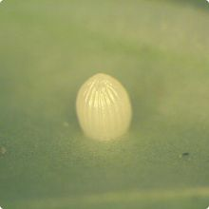
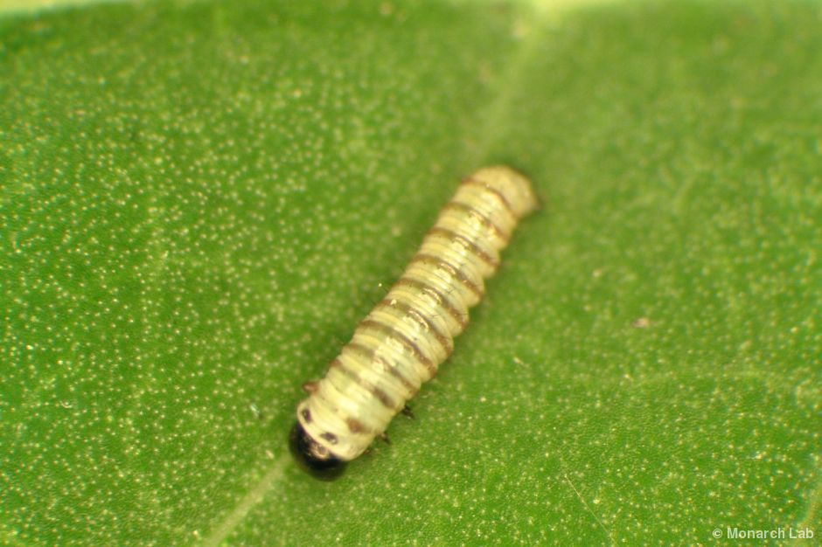
Life Cycle
A single egg is laid on the underside of an Asclepias plant leaf by one female. It is about the size of the head of a straight pin and remains in the egg from for 3-5 days. A female can lay 300-500 eggs over a 2-5 week time frame.
The first (1st) instar is about the size of a grain of rice and remains in this stage for 1-3 days.
Notes:
When the caterpillar is about to emerge from the egg, you can see a black dot on the top of the egg. Nature not wanting to waste anything, the emerged larvae eats it egg case.

Slide 13
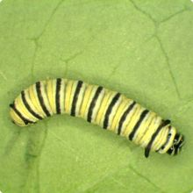
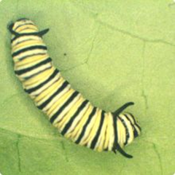
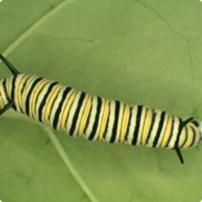
Life Cycle – Instars 2-4
The second (2nd) instar has a length of the diameter of a Crayola crayon and remains in this stage 1-3 days.
The third (3rd) instar is the size of a standard staple and remains in this stage for 1-3 days.
The fourth (4th) instar is the size of the diameter of a quarter and remains in this stage for 1-3 days.

Slide 14
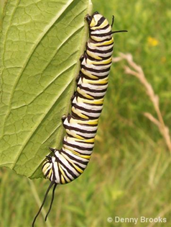
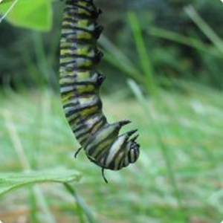
Life Cycle – Instar 5 to chrysalis
The fifth (5th) instar is about 2 ½” long and remains in this stage for 3-5 days.
The fifth instar forms a J shape as it begins to form a chrysalis or pupa.

Slide 15
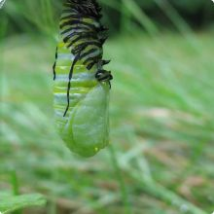
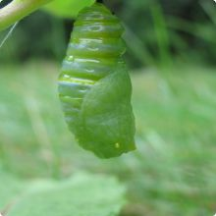
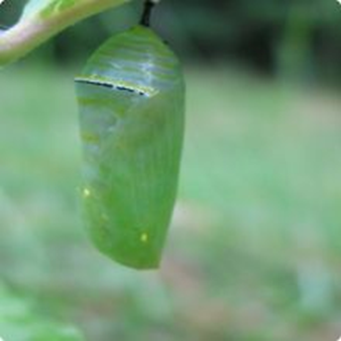
Chrysalis Formation
Changing into a chrysalis (pupa) takes only a matter of minutes. Caterpillars remain in the chrysalis for 8-15 days under normal summer conditions.

Slide 16
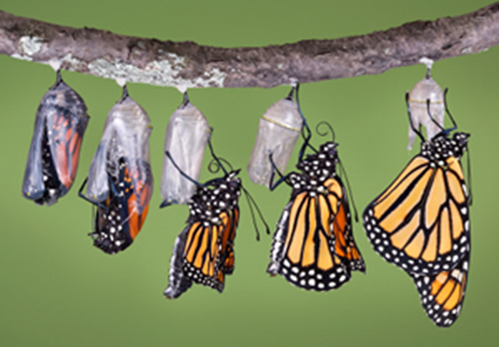
Adult Monarch Eclosing from Chrysalis

Slide 17
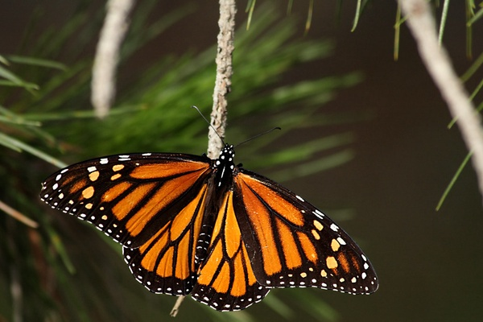
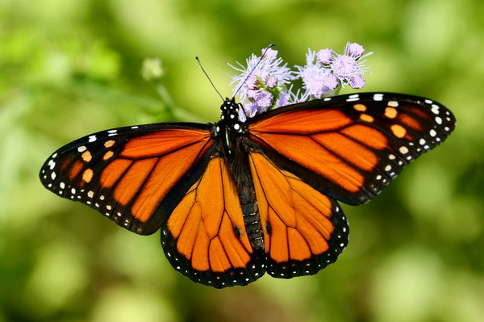
Is it male or female?
CC BY-NC-SA 2.0
CC BY-NC 2.0
Female – Thicker Veins
Male – Thin Veins & Thick Spot

Slide 18
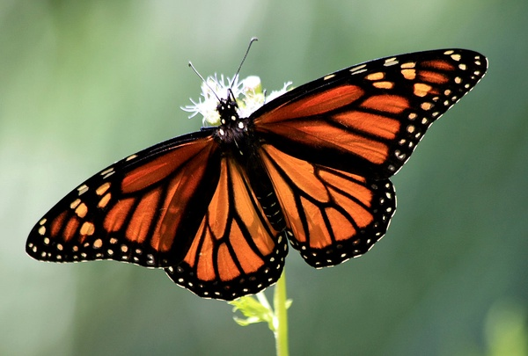
Viceroy vs. Monarch Butterfly
Viceroy
Female Monarch
CC BY-NC 2.0
Viceroy host plants are trees of the willow family, poplars, and cottonwoods.
Note the difference in vein patterns to differentiate the two butterflies.
Source: http://entnemdept.ufl.edu/creatures/bfly/viceroy.htm

Slide 19
Butterflies and Moths
Linnaeus categorized butterflies and moths in the order of Lepidoptera - using Greek terms for wings and scales.
They are one of the largest groups of invertebrates (no spines).
Both have three body parts (head, thorax, and abdomen), two antennae, four wings, and six legs.
Sense organs on their feet can taste food substances.
Adults feed on nectar through a specialized tube called a proboscis which is formed by some of the mouthparts.
www.amentsoc.org/insects/fact-files/orders/lepidoptera.html

Slide 20
Butterflies vs. Moths
Butterflies
Club-shaped antennae
Fold wings vertically
Larger and more colorful
Active during the day
Hard chrysalis to protect pupa
Moths
Feathery antennae
Hold wings like a tent
Smaller and drab coloring
Generally nocturnal
Silk-wrapped cocoon
Source: Library of Congress
Notes:
In the Eric Carle’s book “The Hungry Caterpillar” he mentions that the caterpillar spins a cocoon. It is really a chrysalis.

Slide 21
Host Plants
Butterflies and moths have specific plants on which to lay their eggs.
This is the sole source of food for the caterpillars (larvae).
Monarch butterflies only lay their eggs on the Asclepias species plants.
Asclepias plants produce a toxin which the caterpillars ingest and thus becomes toxic to birds.
Notes:
To attract specific butterflies, you must plant specific plants. For example if you want zebra swallowtails, you must have pawpaw trees. For further information please refer to the work of Dr. Doug Tallamy from the University of Delaware in his book “Bringing Nature Home.”

Slide 22
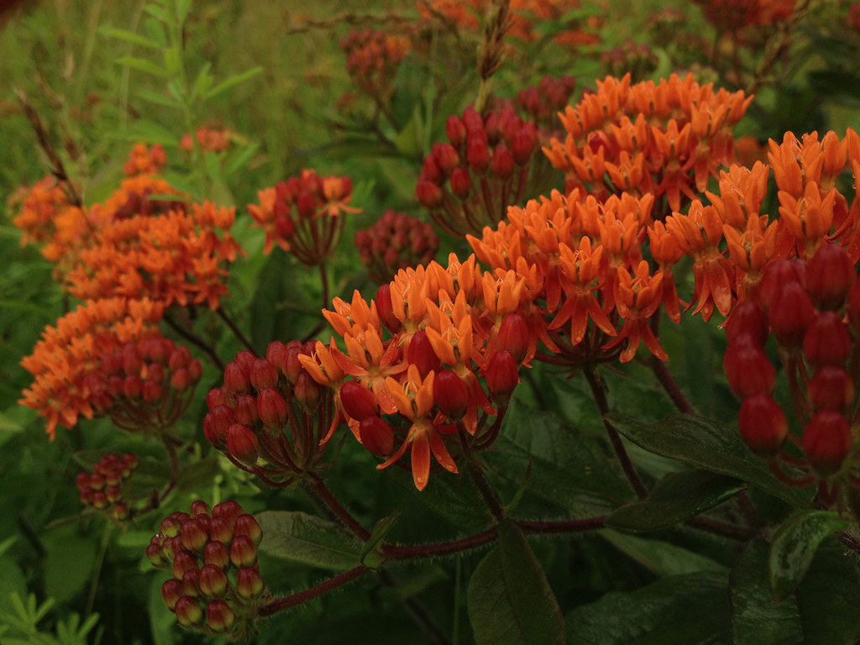
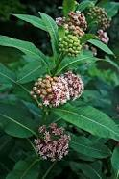
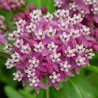
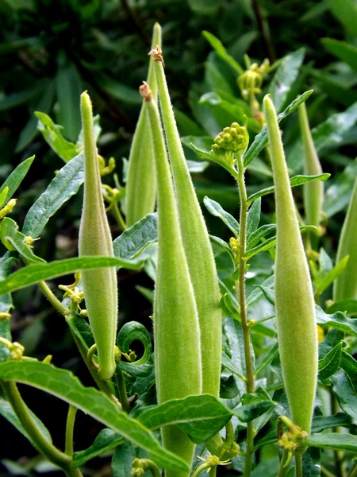
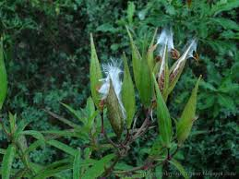
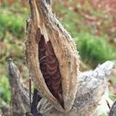
Host Plants
CC BY-SA 2.0
Seed Pod
Seed Pod
CC BY-NC-ND 2.0
Asclepias incarnata
Swamp Milkweed
Asclepias tuberosa
Butterfly Weed
Asclepias syriaca
Common Milkweed
Notes:
Ralph Waldo Emerson said that “ A weed is a plant whose virtues have not yet been discovered.” Specific host plants are needed for specific butterflies or moths to lay eggs. Butterfly caterpillars are the major protein source for baby birds. No food – no baby birds. The common milkweed can grow to be quite tall and will spread over an area. The flowers are very fragrant. The milkweed plant contains toxins that when eaten by the monarch, are concentrated in the caterpillar thus making the butterflies toxic to birds.

Slide 23
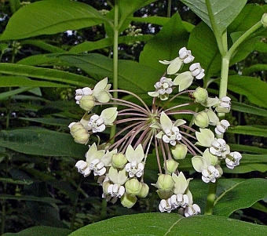
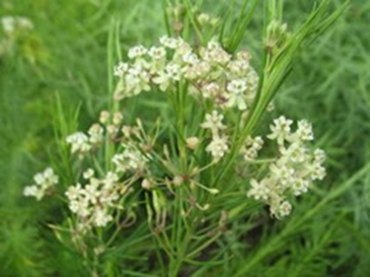
More Milkweeds
Asclepias purpurascens
Purple Milkweed
Asclepias exaltata
Poke Milkweed
Asclepias verticillata
Whorled Milkweed
Source: Finger Lakes Native Plant Society
Source: Missouri Botanical Garden

Slide 24
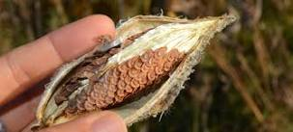
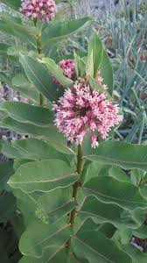
Fun Milkweed Facts
Floss or coma has been used to fill pillows, comforters, jackets, life jackets, blot up oil spills, and start fires if you are a survivalist.
Oil pressed from the seed can be used as a lubricant.
Seed
Floss or Coma
Pod
The French have used the milkweed fibers to produce a silky velvet fabric and by Native Americans to produce rope.
Source: Monarchs and Milkweed by Anurag Agrawal pg. 174-5

Slide 25
Milkweed and the World War II Effort
Children, east of the Mississippi, collected milkweed pods so that the floss from the seeds could be used to make life preservers for airmen and sailors during the war. The floss was a substitute for kapok, which came from Japanese controlled Dutch East Indies (Indonesia).
Source: The Pantagraph from the McLean County Museum of History, Bloomington, Illinois
Notes:
During World War II children east of the Mississippi River collected milkweed pods for harvesting the floss for use in making life preservers for airmen and sailors, as the Japanese controlled the Dutch East Indies, the source of kapok.

Slide 26
Nectar Plants
Nectar (mostly sugars) from flowering plants are necessary for conversion by the butterflies into lipids (fats).
Sugars are a readily available energy source.
Lipid storage is a necessary energy reserve for the overwintering cold-blooded butterflies in Mexico.
No nectar sources are available in the overwintering fir forests of Mexico.
Notes:
All monarchs need nectar which they use as an energy source and as well as to convert into lipids for the fourth generation to overwinter in Mexico, where there is no energy source. It is important to have a variety of nectar sources that will span the entire time that there would be butterflies hatching.

Slide 27
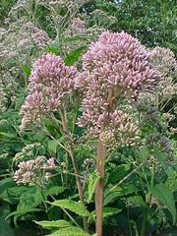
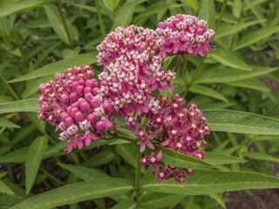
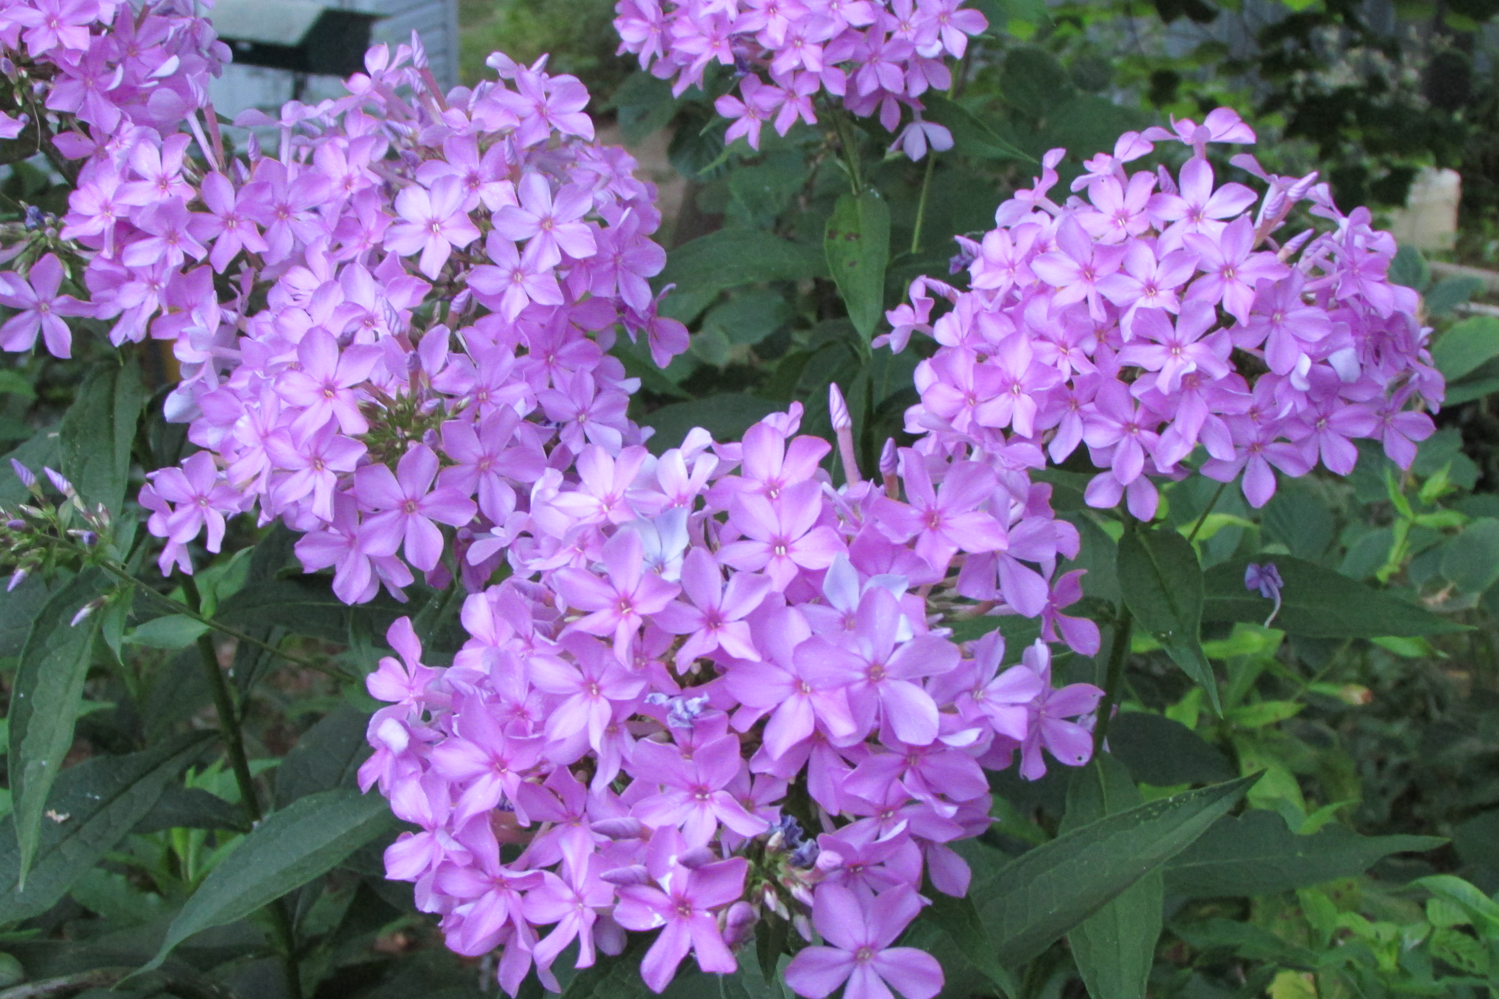
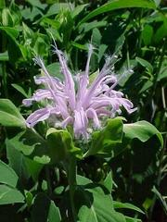
Nectar Source Plants
Summer
Asclepias syriaca
Common Milkweed
Eupatorium purpureum
Joe-Pye Weed
V. Klocko
Asclepias incarnata
Swamp Milkweed
Phlox paniculata
Garden (Summer) Phlox
Monarda fistulosa
Wild Bergamot
Source : National Wildlife Federation and Illinois Wildflowers
Notes:
Common milkweed is a good nectar source, but the blooms do not coincide with the larger monarch arrival.

Slide 28
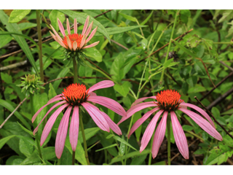
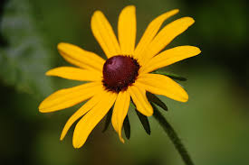
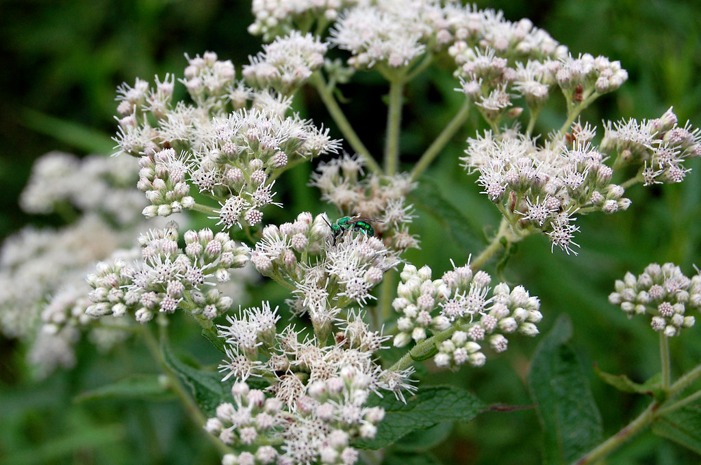
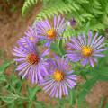
Nectar Source Plants
Summer to Fall
Rudbeckia hirta
Black-eyed Susan
CC BY-NC-SA 2.0
Echinacea purpurea
Eastern Purple Coneflower
Eupatorium perfoliatum
Boneset
Symphyotrichum novae-angliae
New England Aster
Source: National Wildlife Federation
Notes:
New England Asters grow tall and can be cut back several times which will not change their bloom time. Boneset is often found around road edges in early fall.

Slide 29
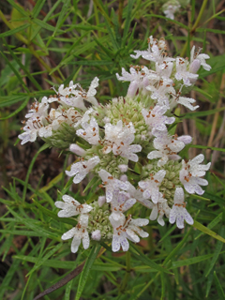
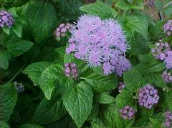
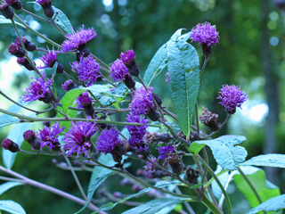
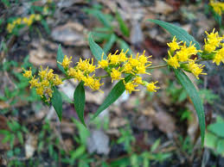
More Nectar Source Plants
Summer to Fall
Conoclinium coelestinum
Blue Mist Flower
Vernonia noveboracensis
New York Ironweed
Solidago caesia
Wreath Goldenrod
Pycnanthemum tenuifolium
Thin Leafed Mountain Mint
Source: National Wildlife Federation
Notes:
Some people might be hesitant to add goldenrod into their garden thinking that this might produce an allergic response. Goldenrod is an insect pollinated plant whereas ragweed, which blooms about the same time, is a wind pollinated plant and is probably the source of the response. Ironweed is a tall, moist to wet sun loving plant. Mountain mint can be a nice ground cover.

Slide 30
Over Wintering in Mexico Areas
Source: JourneyNorth.org
Notes:
This shows the most recent data regarding the overwintering population in 2019. A sustained population of 6 hectacres is a target for monarch recovery.

Slide 31
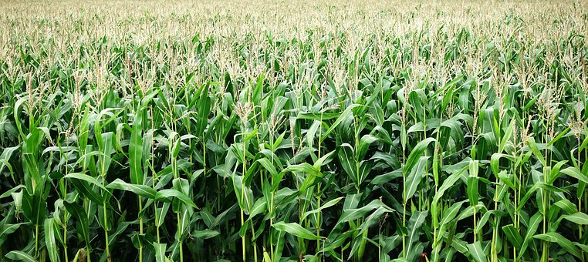
Causes of Monarch Decline
Planting genetically modified corn and soybean crops for use in ethanol production. Yields increased profit to the farmer.
Source: Yale Environment 360
Notes:
Genetically modified plants allow for the use of herbicides for increased production thus killing the milkweed plants.

Slide 32
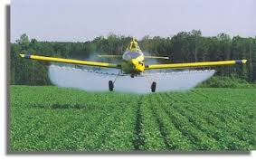
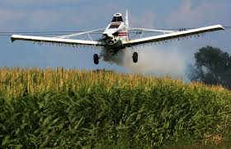
Use of herbicide allows the farmer to spend less time tilling the fields for increased crop production.
Farmers can have second jobs which would allow them to hold onto the farm.
Source: Yale Environment 360

Slide 33
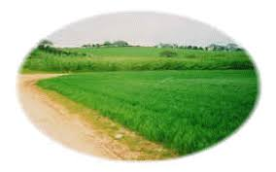
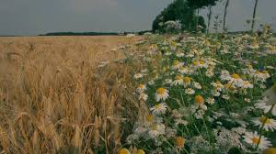
Decreasing crop margins allow for more crops but habitat decreases.
VS.
Source: Yale Environment 360
Notes:
It has been hypothesized that increasing crop margins in the Midwest could control the dead zone in the Gulf of Mexico. It may also be a solution for carbon sequestration as seen in a recent Washington Post article.

Slide 34
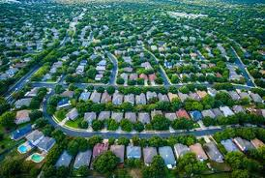
Urban Sprawl
Source: monarchwatch.org

Slide 35
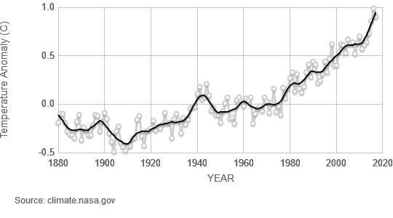
Climate Change

Slide 36
Habitat destruction in overwintering habitats
Illegal logging of the fir trees occurs because of the poverty in the area.
Trees are being cut to plant avocado orchards to meet the demand for the product. Source: https://journeynorth.org/tm/monarch/conservation_overview.html
Notes:
The Mexican Government is trying to control the illegal logging in the fir forests, but because of the poverty in the area it is difficult. One man who was an illegal logger became a steward for the bioreserve and was later found dead.

Slide 37
Severe Weather in Overwintering Habitats
A severe winter storm in January, 2002 was followed by cold conditions. Record low winter temperatures in 2012 and Spring, 2013 delayed breeding which caused decline.
http://www.learner.org/jnorth/spring2002/species/monarch

Slide 38
Lack of Fall Nectar Sources
Dr. Anurag Agrawal hypothesizes
that the lack of fall nectar sources
prevents the monarchs from
producing lipids that will sustain
their journey to Mexico,
overwintering, spring northern
migration, mating, and egg laying.

Slide 39
Other Factors Contributing to Decline
Long migration is inherently risky
Unregulated tourism in fir forests
Competition with humans for resources
Concentration of population in small area is
susceptible to catastrophic events i.e. storms,
drought, disease, and fire
Habitat fragmentation
Source: https://journeynorth.org/tm/monarch/conservation_overview.html

Slide 40
How you can help
journeynorth.org
CC BY 2.0
Provide a water source
Plant milkweed
santafenm.gov
CC BY-NC-ND 2.0
Plant Summer to Fall nectar sources
Use Integrated Pest Management practices

Slide 41
Ecotourism
Ecotourism is a way to support the local economy and enjoy this natural phenomenon.
https://journeynorth.org/tm/monarch/conservation_overview.html
Source: Natural Habitat Adventures & WWF

Slide 42
Source: MonarchWatch.org

Slide 43
References
www.lerner.org/north/monarch/index/html
www.fs.fed.us/wildflowers/pollinators/Monarch_Butterfly/migration/index.shtml
https://www.learner.org/jnorth/tm/monarch/DiaMuertosTG.html
https://www.mexicansugarskull.com/support/dodhistory.html
Wikipedia
Monarch Lab at the University of Minnesota
Monarch-butterfly.com
http://entnemdept.ufl.edu/creatures/bfly/viceroy.htm

Slide 44
References (cont.)
Missouri Botanical Garden
Finger Lakes Native Plant Society
National Wildlife Federation
Illinois Wildflowers
Monarchs and Milkweed by Anurag Agrawal © 2017
The Pantagraph from the McLean County Museum of History, Bloomington, Illinois
Yale Environment 360
climate.nasa.gov

Slide 45
References (cont.)
Natural Habitat Adventures
World Wildlife Federation
https://journeynorth.org/tm/monarch/conservation_overview.html
http://www.learner.org/jnorth/spring2002/species/monarch

Slide 46
Anne Arundel

